Slide 1
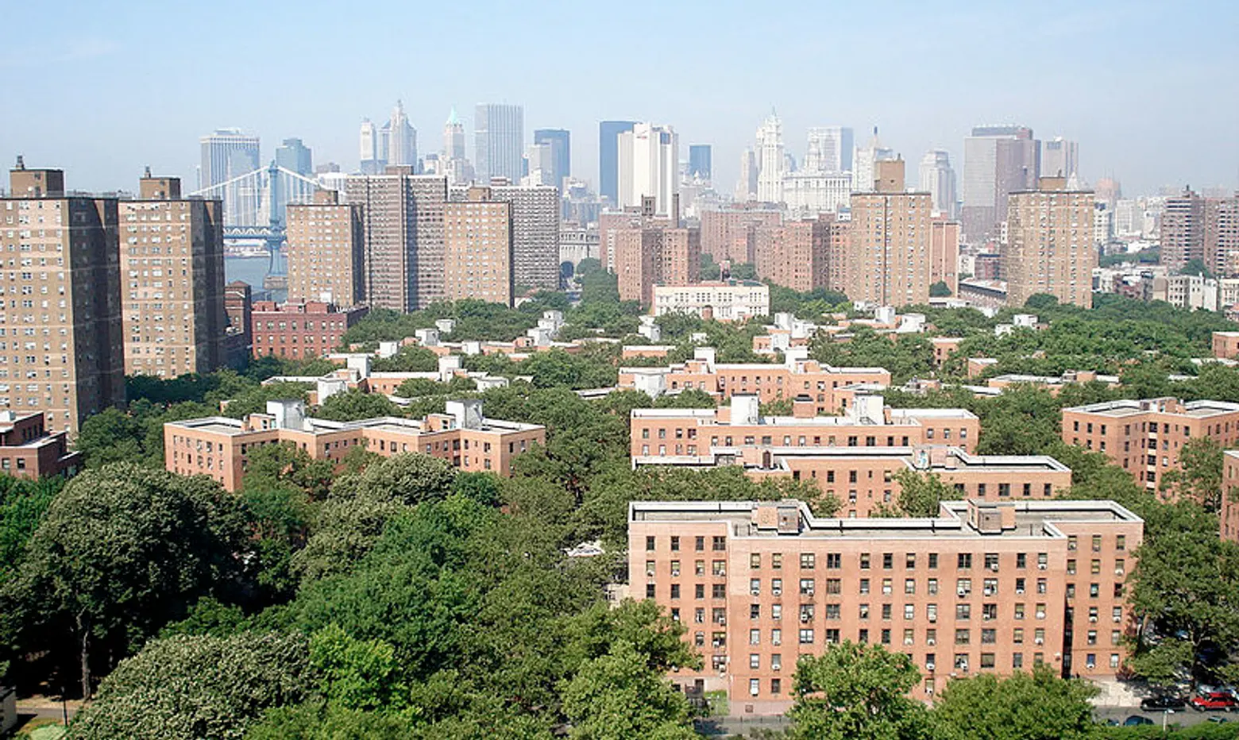
Housing Maintenance Complaints and Violations in NYC
Spring–Summer 2024
Prepared for NYU Furman Center

Slide 2

Uncovering the Dynamics of Housing Issues
Our analysis delves into the intricate patterns of housing maintenance complaints and violations across New York City, seeking to answer critical questions for policy development.
1
Which districts filed the most complaints?
Manhattan 10: 127.5 per 1,000 (2.5x citywide avg)
2
Which districts received the most violations?
Bronx 6, 5, 4: 193, 186, 175 per 1,000
3
What's the relationship between complaints and violations?
Strong correlation (R² = 0.925)
4
Are there temporal trends?
June spike: 130,000+ violations (2.1x normal)

Slide 3
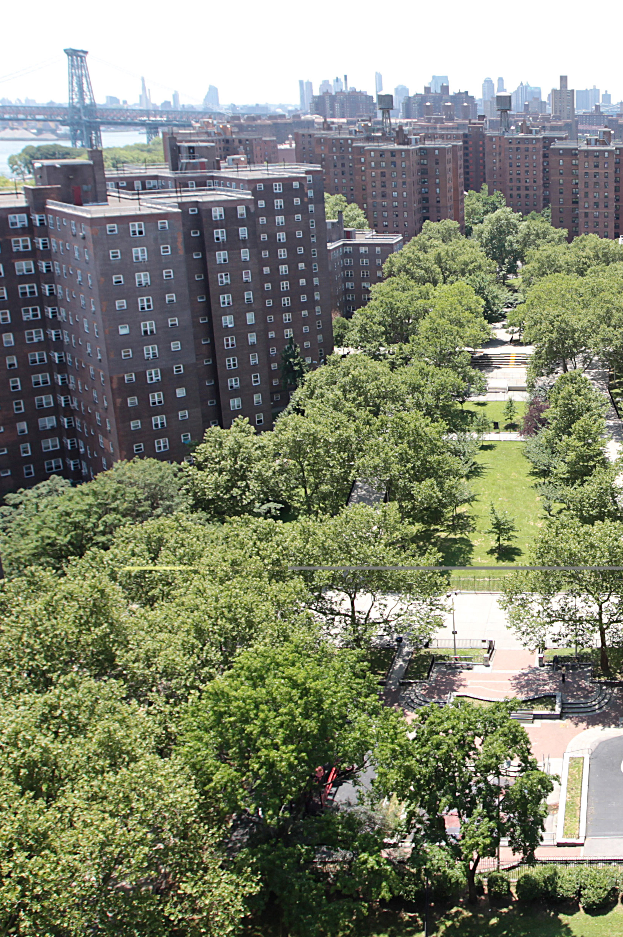
Data & Methodological Framework
Our study leverages comprehensive datasets to provide a robust analysis of housing conditions in NYC.
Data Sources
Sourced from NYC Open Data, focusing on Housing Maintenance Complaints and Violations records.
Data Cleaning
Removed <2% invalid CDs (e.g., Brooklyn 86, Queens 26)
Final Dataset
300,348 complaints, 447,154 violations
Temporal Scope
Analysis covers the period from April to September 2024, capturing critical spring and summer trends.
Geographic Granularity
Data aggregated and analyzed at the community district and borough levels, incorporating Census population data for per-capita metrics.
Key Metrics
Per-capita rates calculated per 1,000 residents to normalize for population differences.

Slide 4
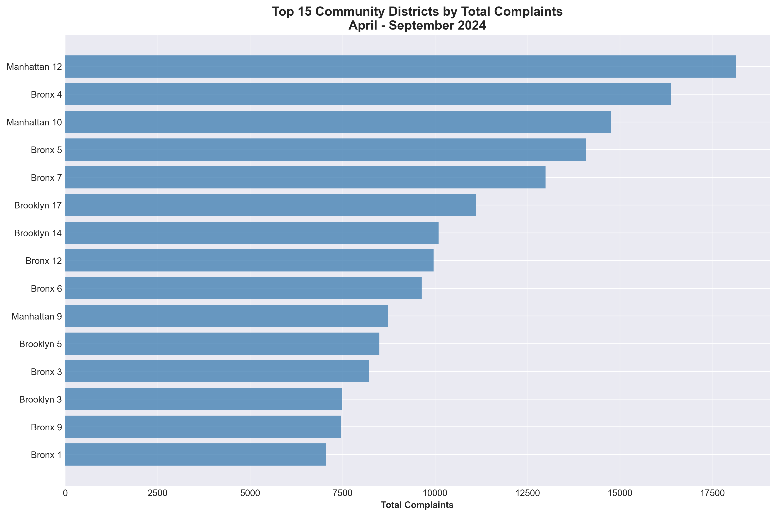
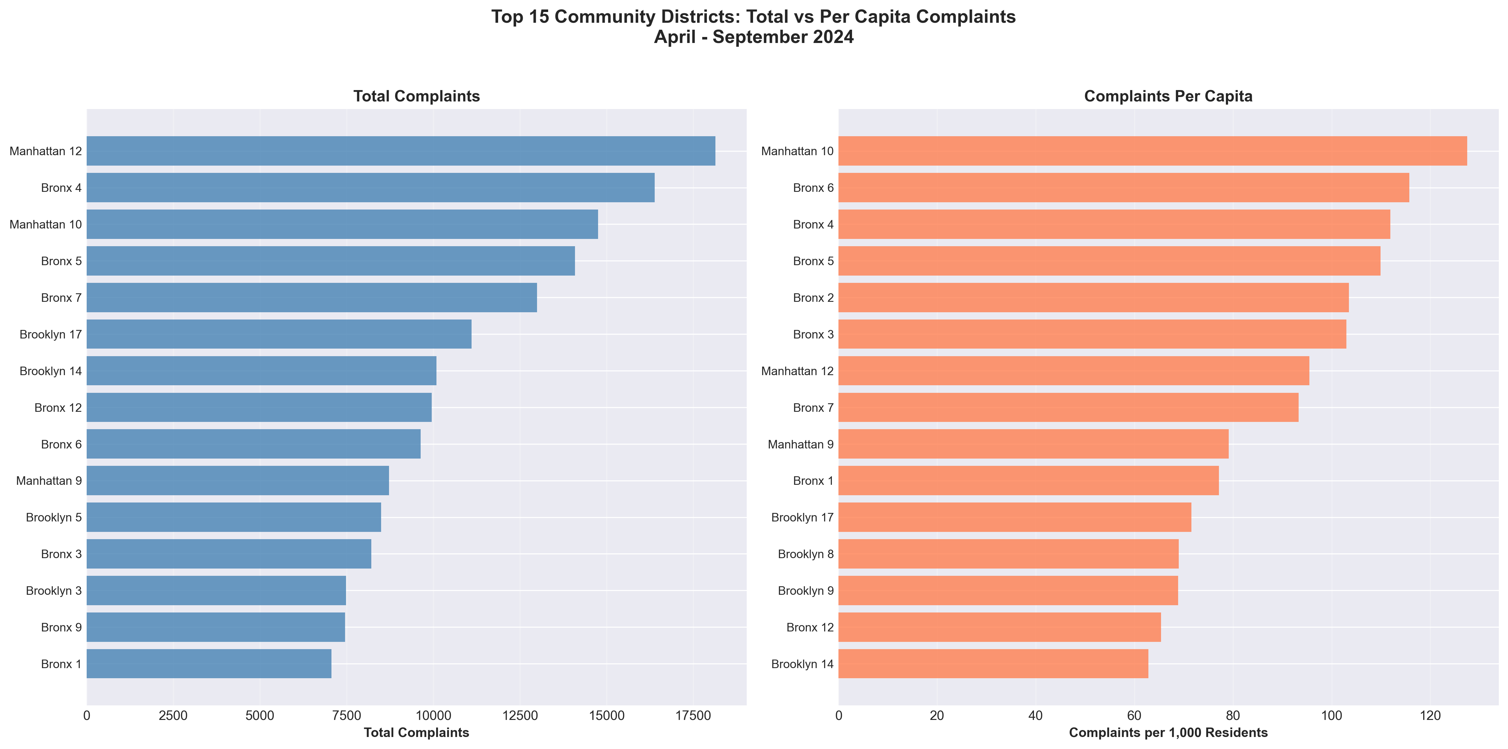
Complaint Concentration: Where Residents Face the Most Issues
An examination of both total and per-capita complaint rates reveals significant disparities across NYC's community districts.
Top 5 Districts by Complaints Per Capita
1. Manhattan 10 (Central Harlem) 127.5 per 1,000
2. Bronx 6 (Belmont/East Tremont) 115.8 per 1,000
3. Bronx 4 (Highbridge/Concourse) 111.9 per 1,000
4. Bronx 5 (Morris Heights) 109.9 per 1,000
5. Bronx 2 (Hunts Point) 103.5 per 1,000
Citywide Average: 50.9 per 1,000
KEY INSIGHT: Bronx districts occupy 4 of top 5 spots
Key Takeaway:
Bronx districts occupy 4 of top 5 spots
Source: NYC Open Data

Slide 5
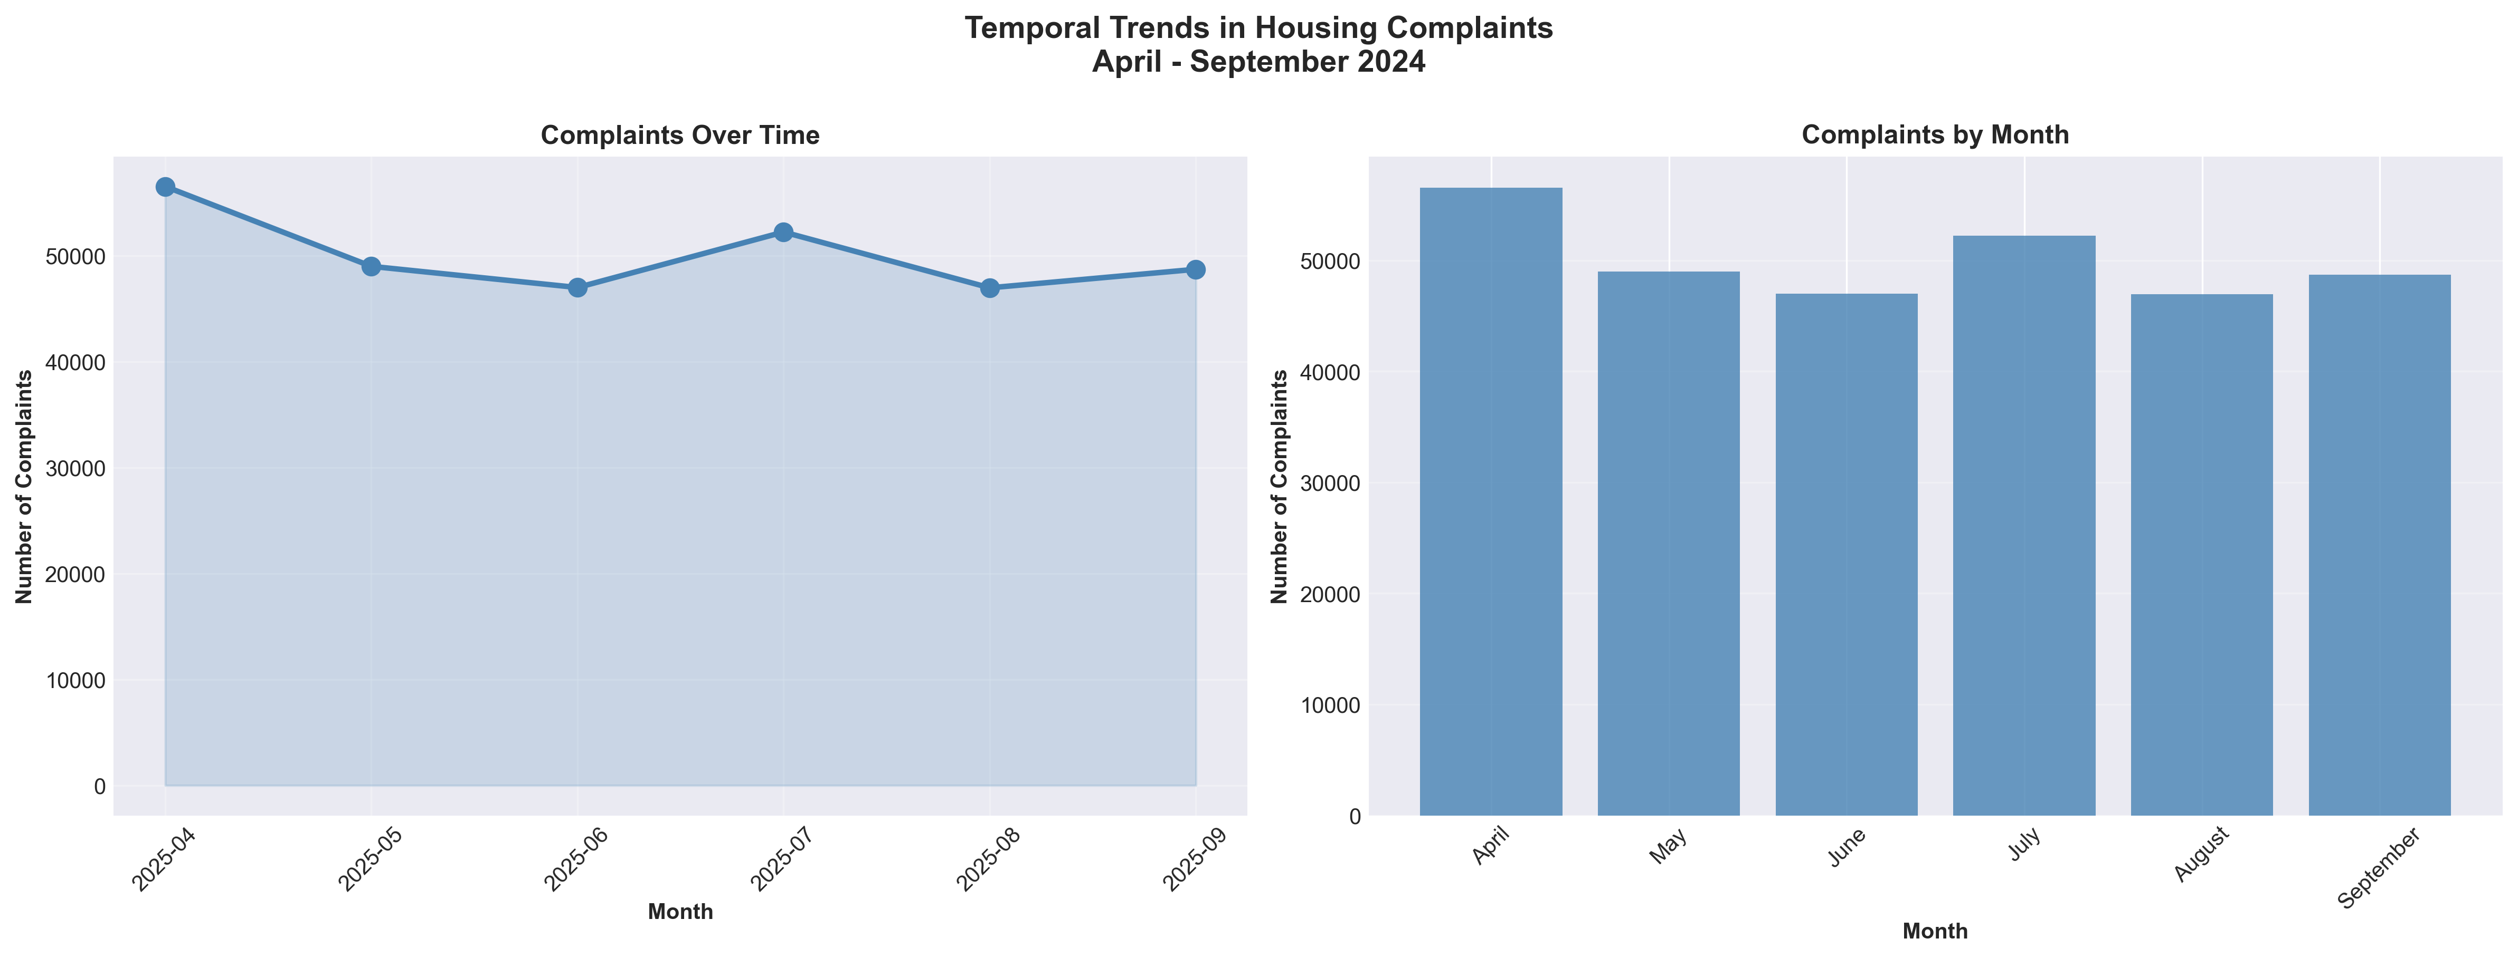
Seasonal Fluctuations in Housing Complaints
Complaint patterns demonstrate clear seasonal trends, likely influenced by environmental factors and resident behaviour.
Analysis of monthly complaint data shows a distinct pattern:
Monthly Complaint Patterns (Apr-Sep 2024)
April: 54,893 complaints (PEAK)
May: 48,967 complaints
June: 46,814 complaints
July: 51,879 complaints (summer increase)
August: 46,916 complaints
September: 48,879 complaints
Summer Peak: A peak is observed in mid-summer (June-July), often correlating with issues like inadequate cooling, pest infestations, or structural problems exacerbated by heat and humidity.
Key Takeaway:
10.8% decline from April to September
Potential cause: Heating season complaints diminish
Source: NYC Open Data

Slide 6
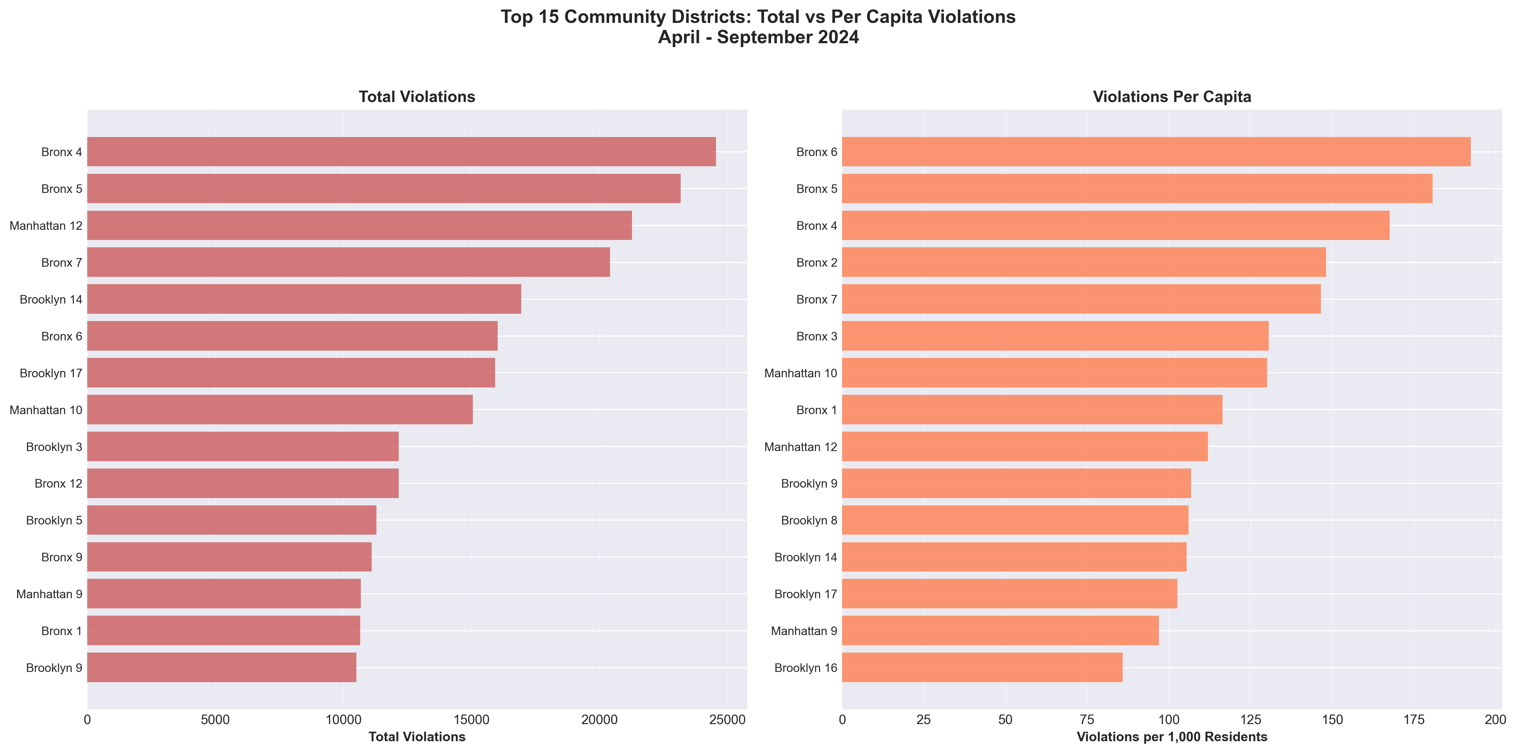
Violation Concentration: Enforcement Hotspots
While complaints are widespread, violations issued by enforcement agencies show a more acute geographic focus.
Top 5 Districts by Violations Per Capita
Bronx 6 193.1 per 1,000 (2.6x citywide avg)
Bronx 5 186.3 per 1,000
Bronx 4 174.9 per 1,000
Bronx 2 134.7 per 1,000
Bronx 7 131.9 per 1,000
Citywide Average: 75.8 per 1,000
Key Takeaway:
Violations are even more geographically concentrated than complaints. Bronx districts prominently dominate the per-capita rankings, suggesting targeted enforcement or particularly severe conditions in these areas.
Source: NYC Open Data

Slide 7
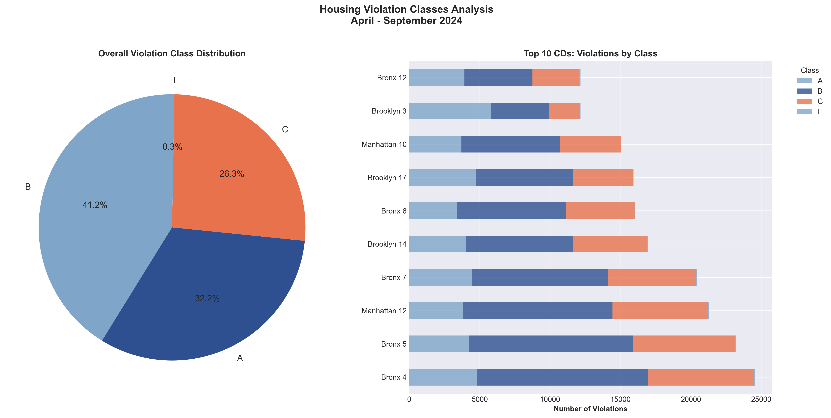
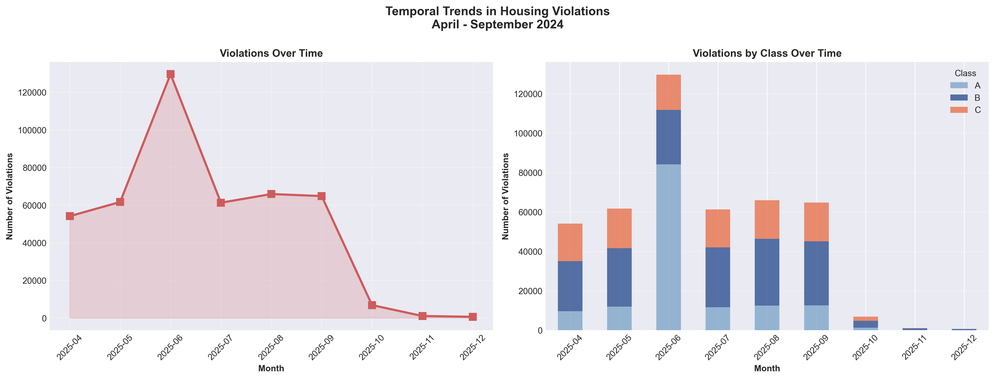
Violation Severity and Seasonal Enforcement
Understanding the nature and timing of violations is crucial for effective policy intervention.
Violation Class Distribution (April-Sept 2024)
Class A (Non-hazardous): 184,213 (41.2%)
Class B (Hazardous): 144,016 (32.2%)
Class C (Immediately Hazardous): 117,681 (26.3%)
Class I (Immediately Hazardous): 1,244 (0.3%)
58.5% are Class B or C (serious violations)
Monthly Peak: June 2024 - 130,928 violations (2.1x the April baseline)
The majority of issued violations fall into the hazardous or immediately hazardous categories.
Enforcement activity, reflected in violation issuance, tends to peak in early summer.
Key Takeaway:
A significant portion of violations address hazardous or immediately hazardous conditions, with enforcement actions peaking in early summer, often in response to the preceding surge in complaints.
Source: NYC Open Data

Slide 8
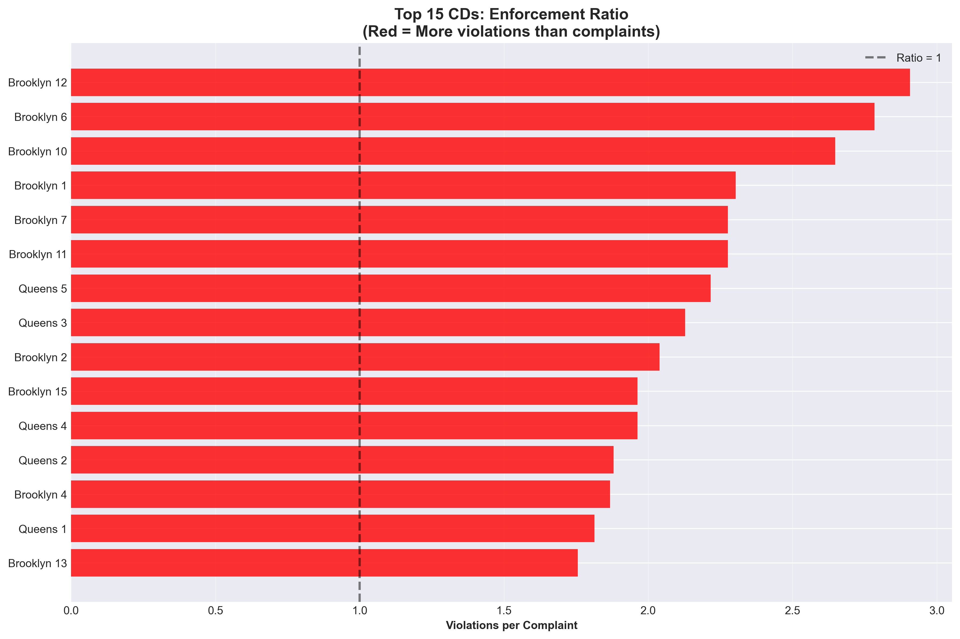
Enforcement Intensity: Translating Complaints into Action
The ratio of violations to complaints indicates the intensity and responsiveness of enforcement efforts across districts.
Violations Per Complaint by District
Top 5 Enforcement Ratios:
Brooklyn 12 3.06 violations per complaint
Brooklyn 6 2.70 violations per complaint
Brooklyn 10 2.58 violations per complaint
Brooklyn 1 2.19 violations per complaint
Brooklyn 7 2.13 violations per complaint
Citywide Average: 1.49 violations per complaint
KEY FINDING: Brooklyn dominates enforcement intensity
When inspected, Brooklyn properties show multiple violations
Complaint Received
Inspection Conducted
Violation Issued
Violations per Complaint
Key Takeaway:
Enforcement intensity varies substantially across community districts. Several districts demonstrate a ratio greater than one, meaning they issue, on average, more than one violation per complaint, indicating either multiple issues per complaint or robust enforcement.
Source: NYC Open Data

Slide 9
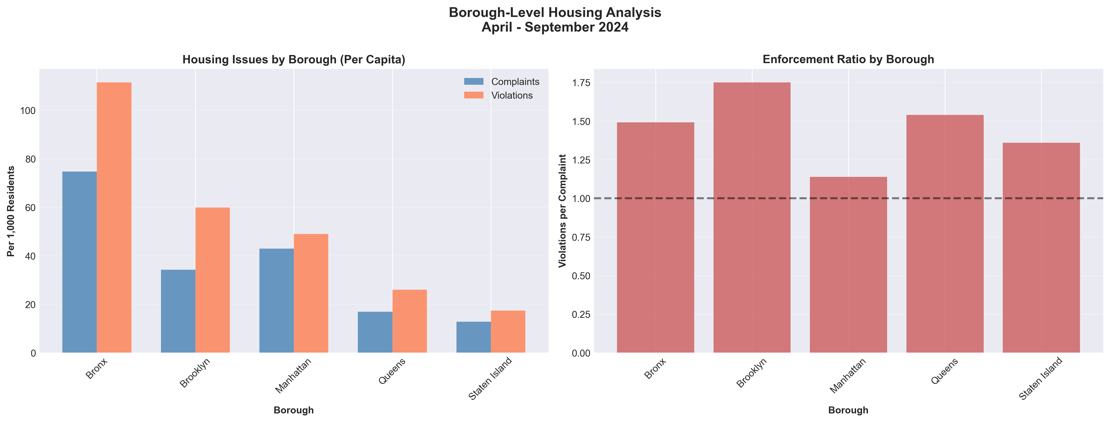
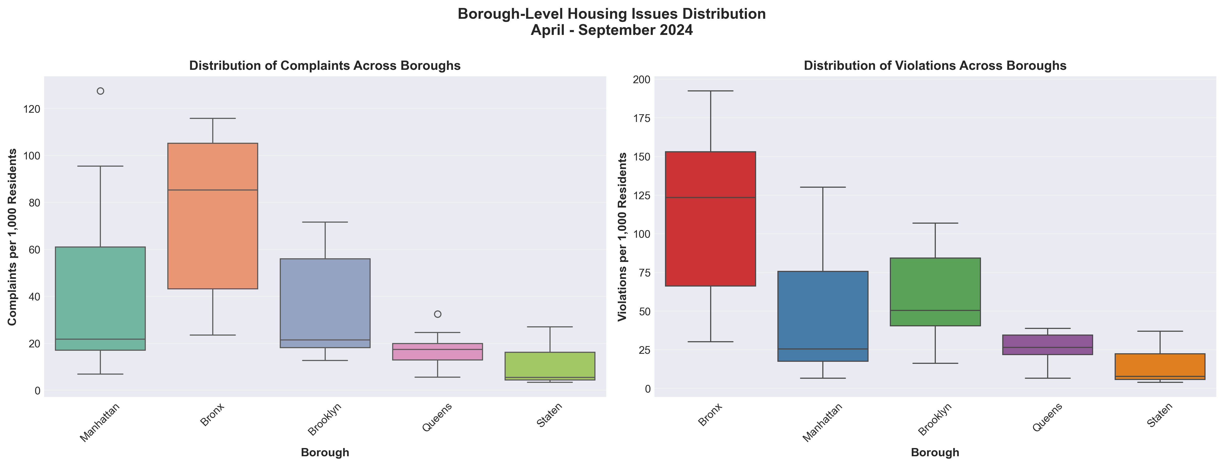
Borough-Level Insights & System-Wide Patterns
Examining broader patterns helps to contextualise district-level findings and reveal systemic trends.
Borough Per-Capita Complaint Comparison
Borough Comparison (Per 1,000 Residents)
Borough Complaints Violations Enforcement Ratio
Bronx 75.6 112.7 1.49
Brooklyn 34.7 60.0 1.73
Manhattan 43.4 49.5 1.14
Queens 17.5 26.6 1.52
Staten Island 12.7 17.5 1.38
KEY INSIGHT: Bronx leads in absolute burden
Brooklyn leads in enforcement intensity
A strong positive correlation exists between the number of complaints and violations issued, indicating that areas with higher reported issues generally experience more enforcement.
Key Takeaway:
While a strong correlation exists between complaints and violations, borough-level analyses highlight differing enforcement strengths and varying burdens of housing issues, suggesting nuances beyond simple complaint counts.
Source: NYC Open Data

Slide 10
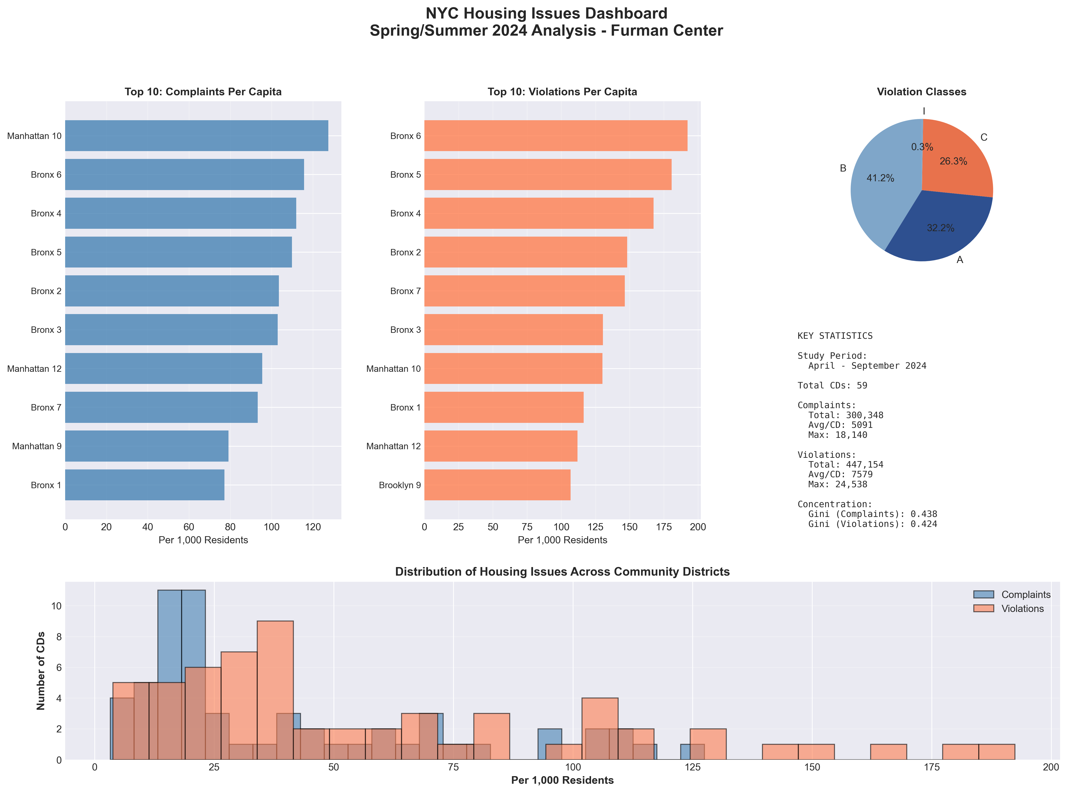
Key Insights & Policy Implications
Source: NYC Open Data" footer to data slides

Slide 11





Key Insights & Policy Implications
Our analysis provides crucial insights for developing more equitable and effective housing policies in NYC.
THE BRONX HOUSING CRISIS
BROOKLYN'S ENFORCEMENT
PARADOX
GEOGRAPHIC CONCENTRATION
4 of top 5 violation districts are in Bronx Rates 2x citywide average
RECOMMENDATION: Targeted Bronx preservation initiative
Gini coefficients: 0.438 complaints, 0.424 violations
Moderate inequality, not extreme RECOMMENDATION: Focus on persistent problem districts
Per-capita metrics are vital for revealing the true burden on residents, normalising for population density.
SEASONAL PATTERNS
STRONG CORRELATION
June spike: 130,000+ violations
RECOMMENDATION: Proactive spring/summer inspections
R² = 0.925 between complaints and violations
Enforcement system is responsive

